Slide 1
Project Scheduling
COMP6100001 - Software engineering
Session 13
Kenny Jingga, S.Kom., M.T.

Slide 2
Session 13 – Project Scheduling
Learning objectives
At the end of this session, students will be expected to be able to:
Understand the Importance of Project Scheduling in Software Engineering
Learn Techniques for Developing Project Schedules
Apply the Critical Path Method (CPM) and Other Scheduling Techniques

Slide 3
Session 13 – Project scheduling
Content outline
Introduction to Project Scheduling
Developing Project Schedules
Critical Path Method (CPM)
Advanced Scheduling Techniques
Tools for Project Scheduling

Slide 4
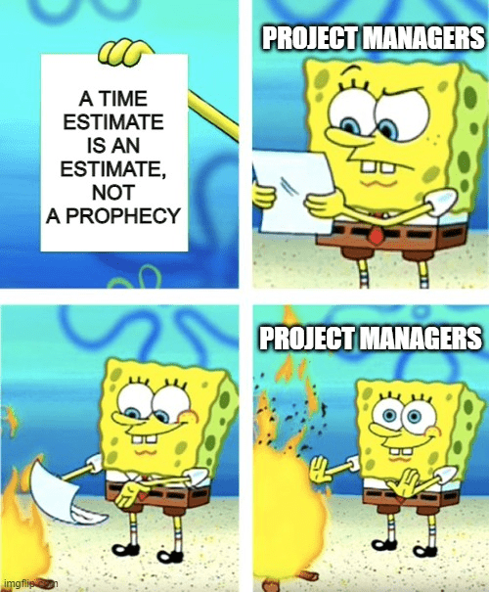
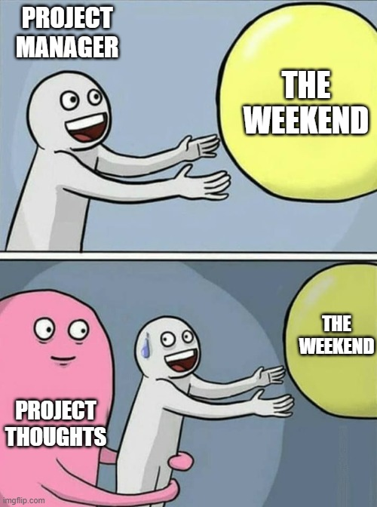
Introduction to Project Scheduling

Slide 5
Introduction to Project Scheduling
Importance of Scheduling in Software Projects
Defines the Timeline: Establishes when tasks and milestones need to be completed.
Resource Planning: Helps allocate resources effectively over time.
Risk Mitigation: Identifies potential bottlenecks and allows for contingency planning.
Stakeholder Communication: Provides a visual representation of the project's progress.

Slide 6
Introduction to Project Scheduling
Overview of Scheduling techniques
Traditional Scheduling Methods: Gantt Charts, PERT, and CPM.
Agile Scheduling Approaches: Iterative development, Scrum sprints.
Hybrid Methods: Combining traditional and agile techniques.

Slide 7
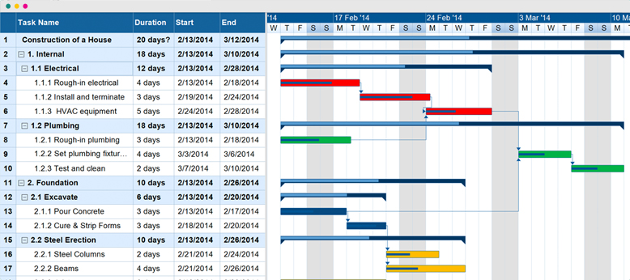
Developing project Schedules
Gantt Charts: Components and interpretation
Tasks/Activities: Work items to be completed.
Timeline: Dates or time periods over which tasks occur.
Bars: Visual representation of task durations.
Dependencies: Relationships between tasks (may be shown with arrows or connectors).
Milestones: Significant points or events in the project.

Slide 8
Developing project Schedules
Gantt Charts: Creating Gantt Charts
Identify Tasks: Break down the project into manageable activities.
Estimate Durations: Assign time estimates to each task.
Define Dependencies: Determine task sequences and relationships.
Construct the Chart: Use software tools or manually draw the chart.
Update Regularly: Reflect changes in the project schedule.

Slide 9

Developing project Schedules
Gantt Charts: Advantages and Limitations
Advantages:
  Easy to understand and communicate.
  Visually depicts the project timeline.
  Helps track progress against planned activities.
Limitations:
  Can become complex for large projects.
  Does not explicitly show task dependencies unless enhanced.
  Static representation; may not adapt well to changes.

Slide 10
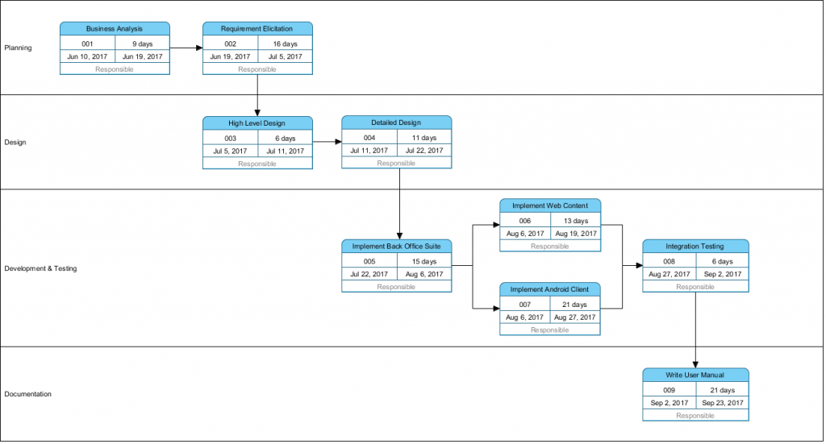
Developing project Schedules
PERT (Program Evaluation Review Technique) Charts: Components And Interpretation
Nodes (Events): Represent milestones or the start/end of activities.
Arrows (Activities): Represent tasks; arrows connect nodes.
Dependencies: The sequence in which tasks must be performed.

Slide 11
Developing project Schedules
PERT (Program Evaluation Review Technique) Charts: Constructing Pert Diagrams
List Activities: Include all tasks required for project completion.
Determine Dependencies: Identify which tasks depend on others.
Estimate Durations: Use optimistic, pessimistic, and most likely estimates if desired.
Draw the Network Diagram: Represent tasks and dependencies visually.

Slide 12
Developing project Schedules
PERT (Program Evaluation Review Technique) Charts: Advantages and Limitations
Advantages:
  Clearly shows task dependencies.
  Helps identify the critical path.
  Useful for projects with uncertain activity durations.
Limitations:
  Can be complex to create and interpret.
  Requires accurate estimation of task durations.
  Not as visually intuitive as Gantt charts for some stakeholders.

Slide 13
Critical Path Method (CPM)
Definition and Purpose
Definition:
  CPM is a step-by-step methodology used to identify critical and non-critical tasks with the goal of preventing time-frame problems and process bottlenecks.
Purpose:
  Determine the longest stretch of dependent activities.
  Calculate the shortest possible project duration.
  Identify tasks that have flexibility (float) and those that do not.

Slide 14
Critical Path Method (CPM)
Steps to Determine the Critical Path
List All Activities: Breakdown the project into individual tasks.
Identify Dependencies: Understand the sequence of tasks.
Estimate Activity Durations: Assign realistic time estimates.
Create the Network Diagram: Visualize tasks and dependencies.
Calculate Earliest Start (ES) and Earliest Finish (EF) Times: Using forward pass.
Calculate Latest Start (LS) and Latest Finish (LF) Times: Using backward pass.
Determine Float (Slack) Times: Calculate for each activity.
Identify Critical Path: The path with zero total float.

Slide 15
Critical Path Method (CPM)
Forward and Backward Pass Calculations
Forward Pass (Earliest Times)
Earliest Start (ES): The earliest time an activity can begin.
  ES for starting activities: Zero.
  ES for subsequent activities: ES = Maximum EF of all immediate predecessors.
Earliest Finish (EF): EF = ES + Activity Duration.
Backward Pass (Latest Times)
Latest Finish (LF): The latest time an activity can finish without delaying the project.
  LF for ending activities: Equal to the project's earliest finish time.
  LF for preceding activities: LF = Minimum LS of all immediate successors.
Latest Start (LS): LS = LF - Activity Duration.

Slide 16
Critical Path Method (CPM)
Float (Slack) Time Analysis
Total Float: The amount of time an activity can be delayed without affecting the project's end date.
  Total Float = LS - ES or Total Float = LF - EF.
Free Float: Time an activity can be delayed without affecting the ES of subsequent activities.
Zero Float: Indicates activities on the critical path.

Slide 17
Critical Path Method (CPM)
Example
Project: Developing a New Mobile Application.
Activities, Durations, and Dependencies:
Activity | Description | Duration (Days) | Predecessors
A | Requirements Gathering | 4 | -
B | UI Design | 3 | A
C | Backend Design | 5 | A
D | Frontend Development | 6 | B
E | Backend Development | 8 | C
F | Integration | 2 | D, E
G | Testing | 4 | F
H | Deployment | 1 | G

Slide 18
Critical Path Method (CPM)
Example
Task:
  Construct the network diagram
  Perform forward and backward pass calculations
  Determine ES, EF, LS, LF, and float for each activity
  Identify the critical path

Slide 19
Critical Path Method (CPM)
Example: Create Network Diagram
Task:
  Construct the network diagram
  Perform forward and backward pass calculations
  Determine ES, EF, LS, LF, and float for each activity
  Identify the critical path

Slide 20
Critical Path Method (CPM)
Example: Perform Forward Pass
Activity A:
  ES = 0
  EF = ES + Duration = 0 + 4 = 4
Activity B:
  ES = EF of A = 4
  EF = 4 + 3 = 7
Activity C:
  ES = EF of A = 4
  EF = 4 + 5 = 9
Activity D:
  ES = EF of B = 7
  EF = 7 + 6 = 13
Activity E:
  ES = EF of C = 9
  EF = 9 + 8 = 17
Activity F:
  ES = Max(EF of D, EF of E) = Max(13, 17) = 17
  EF = 17 + 2 = 19
Activity G:
  ES = EF of F = 19
  EF = 19 + 4 = 23
Activity H:
  ES = EF of G = 23
  EF = 23 + 1 = 24

Slide 21
Critical Path Method (CPM)
Example: Perform Backward Pass
Activity H:
  LF = Project EF = 24
  LS = LF - Duration = 24 - 1 = 23
Activity G:
  LF = LS of H = 23
  LS = LF - Duration = 23 - 4 = 19
Activity F:
  LF = LS of G = 19
  LS = LF - Duration = 19 - 2 = 17
Activity D:
  LF = LS of F = 17
  LS = LF - Duration = 17 - 6 = 11
Activity E:
  LF = LS of F = 17
  LS = LF - Duration = 17 - 8 = 9
Activity B:
  LF = LS of D = 11
  LS = LF - Duration = 11 - 3 = 8
Activity C:
  LF = LS of E = 9
  LS = LF - Duration = 9 - 5 = 4
Activity A:
  LF = Min(LS of B, LS of C) = Min(8, 4) = 4
  LS = LF - Duration = 4 - 4 = 0

Slide 22
Critical Path Method (CPM)
Example: Calculate float for each activity
Activity A:
  Total Float = LS - ES = 0 - 0 = 0
Activity B:
  Total Float = 8 - 4 = 4
Activity C:
  Total Float = 4 - 4 = 0
Activity D:
  Total Float = 11 - 7 = 4
Activity E:
  Total Float = 9 - 9 = 0
Activity F:
  Total Float = 17 - 17 = 0
Activity G
  :Total Float = 19 - 19 = 0
Activity H:
  Total Float = 23 - 23 = 0

Slide 23
Critical Path Method (CPM)
Example: Identify Critical Path
Activities with zero total float: A → C → E → F → G → H
Critical Path: A-C-E-F-G-H
Project Duration: 24 days

Slide 24
Advanced ScheduLing Techniques
Agile and Iterative Scheduling
Timeboxing: Allocating a fixed time period for each process.
Sprints: Short, consistent durations (e.g., 2 weeks) where specific work is completed.
Backlogs and Burn-down Charts: Tools to manage and visualize progress.

Slide 25
Advanced ScheduLing Techniques
Timeboxing and Sprint Planning
Timeboxing Benefits:
  Encourages focus on priorities.
  Improves predictability and efficiency.
  Facilitates regular delivery of increments.
Sprint Planning:
  Define sprint goals.
  Select backlog items to include.
  Estimate tasks and assign responsibilities.

Slide 26
Advanced ScheduLing Techniques
Resource-Constrained Scheduling
Definition: Adjusting the schedule based on resource availability.
Techniques:
  Resource Leveling: Modifying task schedules to minimize resource peaks and valleys.
  Resource Allocation Heuristics: Prioritizing tasks based on criticality and resource demands.

Slide 27
Advanced ScheduLing Techniques
Fast Tracking and Crashing Techniques
Fast Tracking:
  Performing tasks in parallel that were originally planned in sequence.
  Risks: Increased complexity, potential for rework.
Crashing:
  Adding resources to critical path tasks to shorten durations.
  Considerations: Diminishing returns, increased costs.

Slide 28
Tools for Project Scheduling
Software Tools
Microsoft Project:
  Comprehensive project management tool.
  Features: Gantt charts, resource management, reporting.
Jira:
  Focused on agile project management.
  Features: Backlogs, sprint planning, issue tracking.
Asana:
  Flexible project management platform.
  Features: Task lists, timelines, collaboration tools.

Slide 29
Tools for Project Scheduling
Best Practices for using scheduling tools
Regular Updates: Keep schedules current to reflect actual progress.
Collaboration: Use tools that support team communication and collaboration.
Training: Ensure team members are proficient with the selected tools.
Customization: Tailor tools to fit the project's specific needs.

Slide 30
References
Titus Winters, Tom Manshreck, and Hyrum Wright. (2020). Software Engineering at Google: Lesson Learned from Programming Over Time. 1st. O’Reilly Media. California. ISBN: 978-1492082798. Page 69-122.
Roger Pressman and Bruce Maxim. (2020). Software Engineering: A Practitioner's Approach. 9th. McGraw Hill. New York. ISBN: 978-1259872976. Chapter 24.
Ian Sommerville. (2016). Software Engineering. 10th. Pearson. London. ISBN: 978-1-292-09613-1. Chapter 22.
Project Management Institute. (2021). A Guide to the Project Management Body of Knowledge (PMBOK Guide) (7th Edition). Project Management Institute

